Slide 1



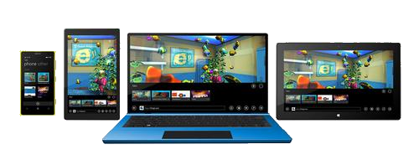
Data-binding List Controls
In Windows Universal Applications

Slide 2

Table of Contents
The ViewModel
DataContext of the View
Binding List Controls
Binding enumerable objects to List controls
Using Data Templates

Slide 3
The ViewModel
The way to abstract the UI from the BL

Slide 4
The ViewModel
The ViewModel is a Model-of-the-View
Exposes public properties for View to bind
ViewModel objects are the objects that do most of the work
Except UI
The ViewModels needs to:
Perform data storage operations
Contain business logic

Slide 5
The ViewModel
In most cases a ViewModel is a POCO object
Nothing special about it
Contains little or no XAML/WPF/SL dependencies and references
Yet the ViewModel cannot be absolutely decoupled from the XAML platform
In some cases it needs to inherit from INotifyPropertyChanged

Slide 6
The ViewModel
Live Demo

Slide 7
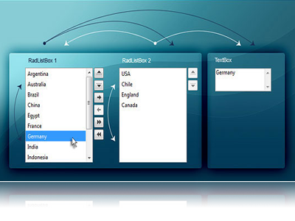
Binding List Controls
DisplayMemberPath and SelectedValuePath

Slide 8
Binding List Controls
List controls like ListBox and ComboBox display multiple items at a time
Can be bound to a collection in the ViewModel/DataContext
Can keep track of the current item
When binding the DisplayMemberPath specifies the property to be displayed
The SelectedValuePath specifies the property to be used as selected value (some ID)

Slide 9
DisplayMemberPath
If we want to show every object of the PhonesStore class and display one of its properties
The ListBox class provides the DisplayMemberPath property
<ListBox
ItemsSource="{Binding Phones}"
DisplayMemberPath="Model"
IsSynchronizedWithCurrentItem = "True"
/>

Slide 10
SelectedValuePath
The ItemsControl class provides a path to describe the selected value of a piece of data
Data which is often used when the selection changes or an item is double-clicked
<ListBox Name="ListBoxPeople" ItemsSource="{Binding}"
DisplayMemberPath="Name" SelectedValuePath="Age" />
private void ListBoxPeople_SelectionChanged(
object sender, SelectionChangedEventArgs e)
{
int index = ListBoxPerson.SelectedIndex;
if (index < 0) { return; }
Person item = (Person) ListBoxPerson.SelectedItem;
int value = (int) ListBoxPerson.SelectedValue; …
}

Slide 11
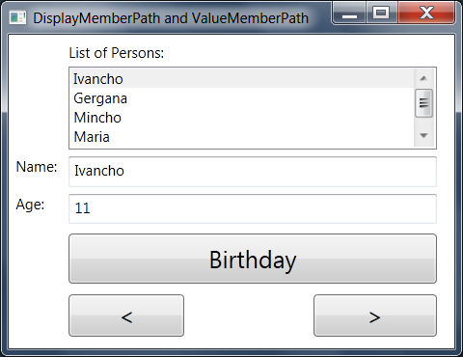
DisplayMemberPath and SelectedValuePath
Live Demo

Slide 12
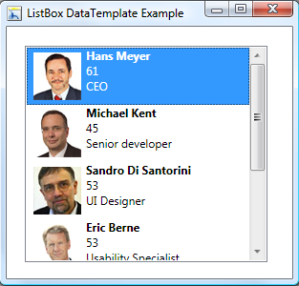
Using Data Templates

Slide 13
Using Data Templates
Data templates allow displaying more than one property from a custom class
A data template is a tree of elements to expand in a particular context
For example, for each Phone object, you might like to be able to concatenate the Vendor, Model and Year together
This is a logical template that looks like this
Year: Vendor Model

Slide 14
Using Data Templates (2)
To define this template for items in the ListBox, we create a DataTemplate element
<ListBox ItemsSource="{Binding}">
<ListBox.ItemTemplate>
<DataTemplate>
<TextBlock>
<TextBlock Text="{Binding Year}" />:
<TextBlock Text="{Binding Vendor}" />
<TextBlock Text="{Binding Model}" />
</TextBlock>
</DataTemplate>
</ListBox.ItemTemplate>
</ListBox>

Slide 15
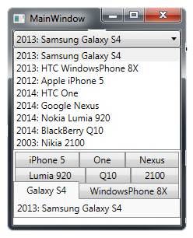
Using Data Templates (2)
The ListBox control has an ItemTemplate property
Accepts an instance of the DataTemplate class
The ListBox shows all the items in the collection

Slide 16
Using Data Templates
Live Demo

Slide 17
Data-binding List Controls
http://academy.telerik.com

Slide 18
Exercises
Write a program to manage a simple system with information about towns and countries. Each country is described by name, language, national flag and list of towns. Each town is described by name, population and country. You should create navigation over the towns and countries. Enable editing the information about them. Don't use list controls but only text boxes and simple binding
Rewrite the previous exercise using list controls.

